Slide 1
CSG – EEG Toolbox
2016

Slide 2
Installation
Installer SPM: http://www.fil.ion.ucl.ac.uk/spm/software/spm12/
2) ‘Fasst’ toolbox (see in the CSGtoolbox zip)
3) ‘CSG’ toolbox (see in the CSGtoolbox zip): has to be put on the top in the matlab set path.

Slide 3
EEG preprocessing
Automatic preprocessing

Slide 4
‘CSG_preprocessing’
Preprocess your raw data via the ‘CSG_preprocessing’ function
New files are created:
1) the header and data files: .mat and .dat respectively
2) The filtered data: P_filename
3) Bad channels interpolated and detected: IP_filename

Slide 5
‘CSG_preprocessing’ Pipeline
Convert data to the SPM format
Clone data: Preprocessed data are saved under the name ‘P_initialdataname’
Filter data: EEG and other channels: [0.1-30]Hz, EOG channels: [0.1-5]Hz, EMG channels: [10-125]Hz.
Bad channels detection over large time-windows(‘CSG_badchannels’)
Interpolation of bad channels (‘CSG_interpol’)
Bad channels detected over small epochs (‘CSG_artefact’).
Three submethods are used to detect bad channels to check coherence:
between closed channels,
over small time-windows
over the whole recording
7) Rereferencing to the average of all channels

Slide 6
EEG rereferencing
CSG toolbox

Slide 7
‘CSG_reref’ (256 channels)
You can rereference data to the average of the 256 channels:
- use the ‘CSG_reref’ function located in CSG/subfunction
- give in ‘origdir’ the path related to the toolbox ‘CSG’
- launch the function and select the ‘IP_filename’ file. It will return the file ‘MIP_filename’

Slide 8
EEG display
CSG toolbox

Slide 9
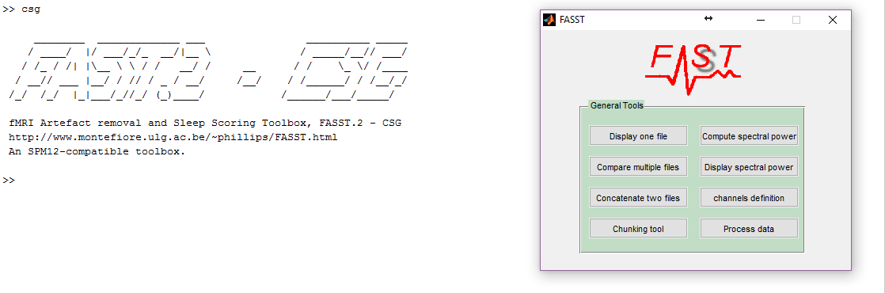
‘CSG’

Slide 10
Display

Slide 11
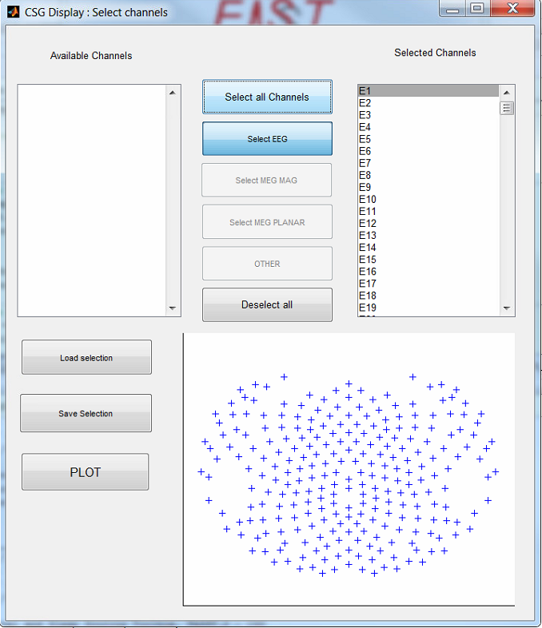
Channels selection

Slide 12
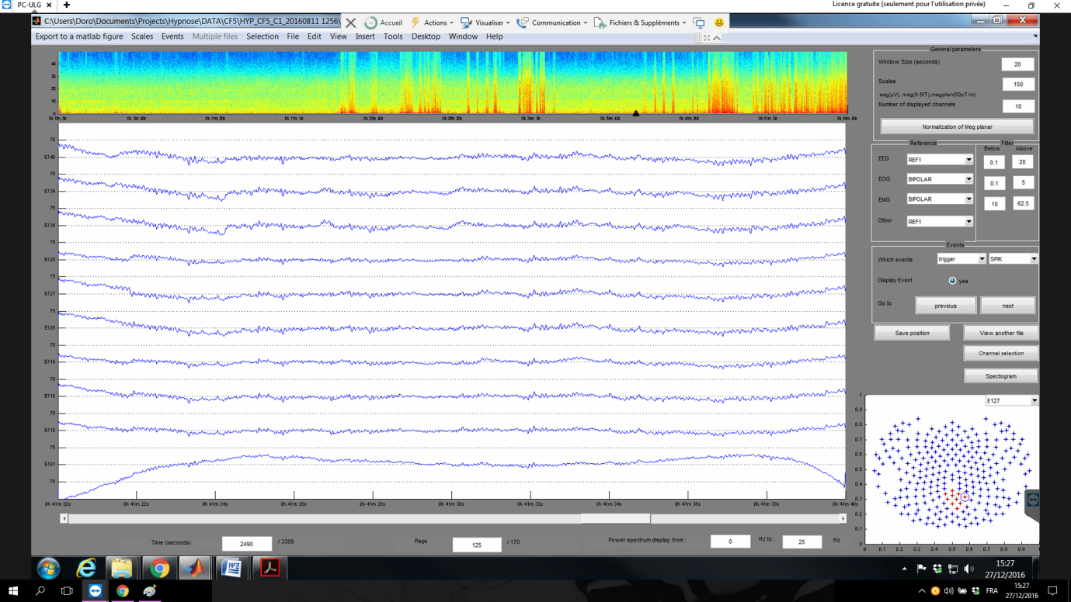
Interface
To choose:
the time window length
the number of channels to display
the scale
To compute the spectrogram
To change the filtering
To display events
Save the current window for the next opening of this file
To go on specific channels (in red): either by selecting the channel or clicking on the map

Slide 13
EEG preprocessing
Manual Preprocessing

Slide 14
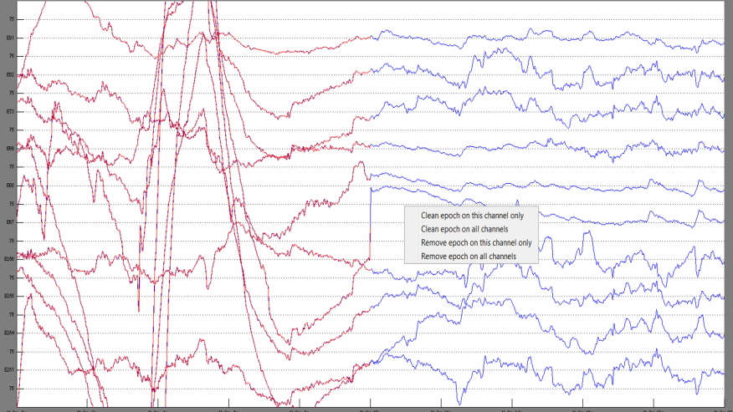
Refine the preprocessed data
Display the EEG datafile preprocessed.
Click right on the EEG channel (s) you want to consider as cleaned or artefacted.

Slide 15
Questions
If you have questions, you can ask to Jitka or me (by email)
Could you take notes of error messages or suggestions you have in order to improve the following beta version ;)
Thanks

